Slide 1
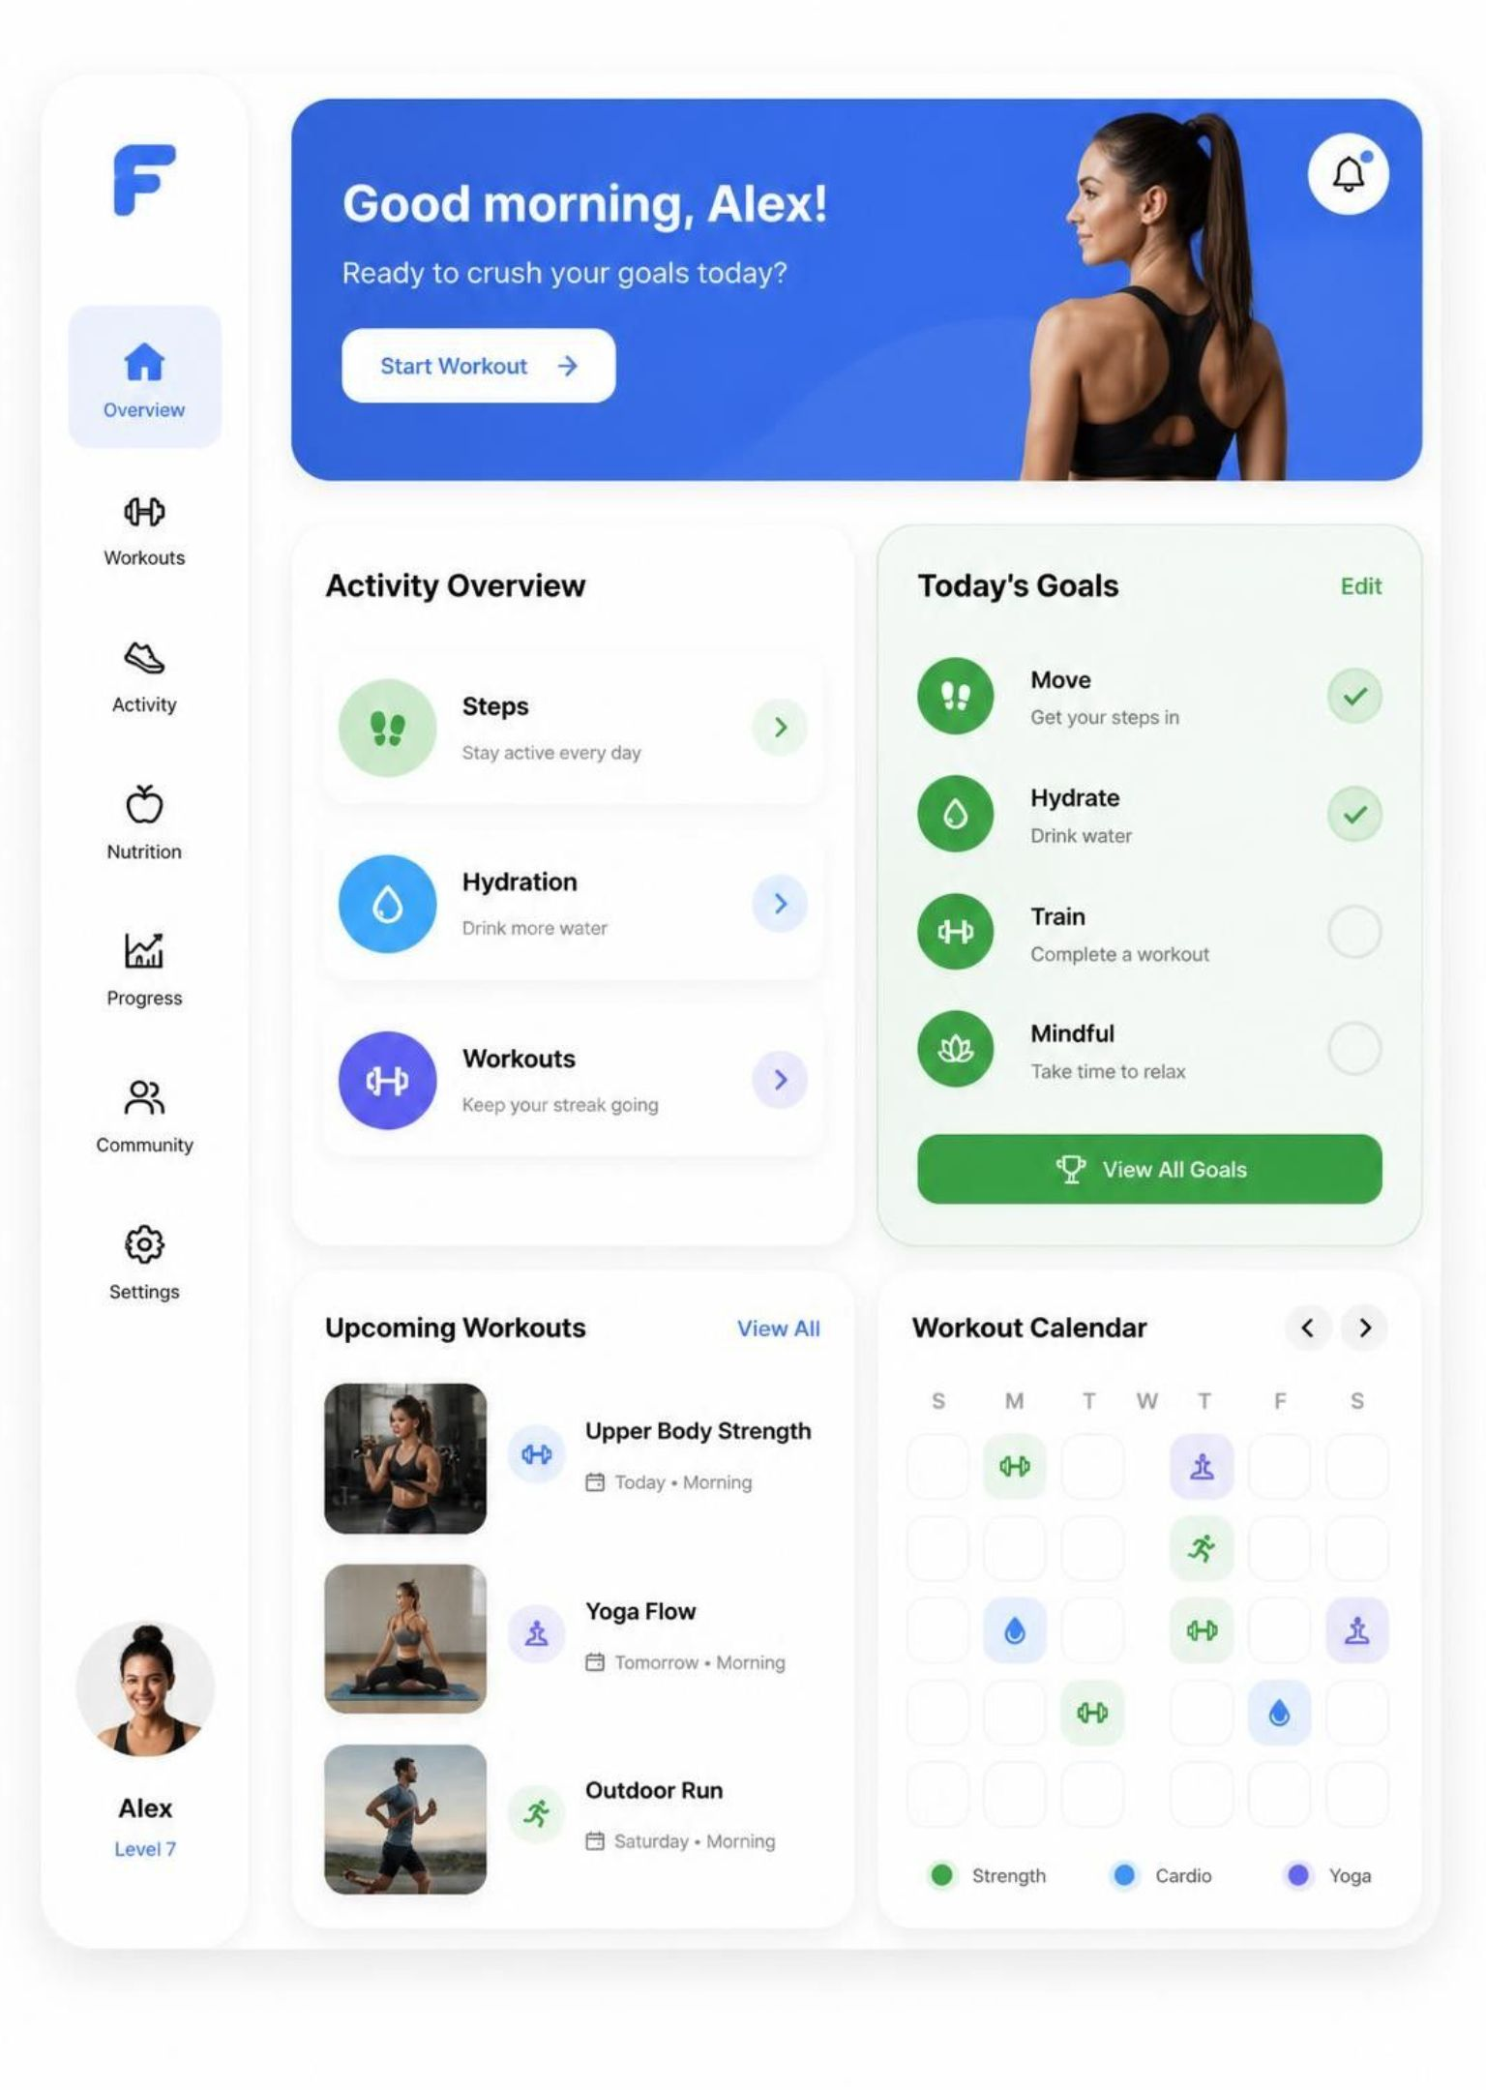
Fitness Activity
Dashboard Planner
A smart dashboard that helps users track daily fitness activities and plan their workouts.
Team Members: [PRANAY.CH]
[A.SWARAJ KUMAR]
[K.YAKSHIT]
[CH.NEERAJ]
Notes:
Introduce the team and the project domain. The idea is to put daily activity tracking and workout planning in one approachable dashboard.

Slide 2




Staying consistent is hard without clear tracking
Routines slip
Many people struggle to keep a regular fitness routine.
Tracking gets scattered
Steps, calories, workouts, and water are hard to track.
Goals stay unclear
Users can't tell if they're hitting their goals. No planning leads to inconsistent habits.

Slide 3
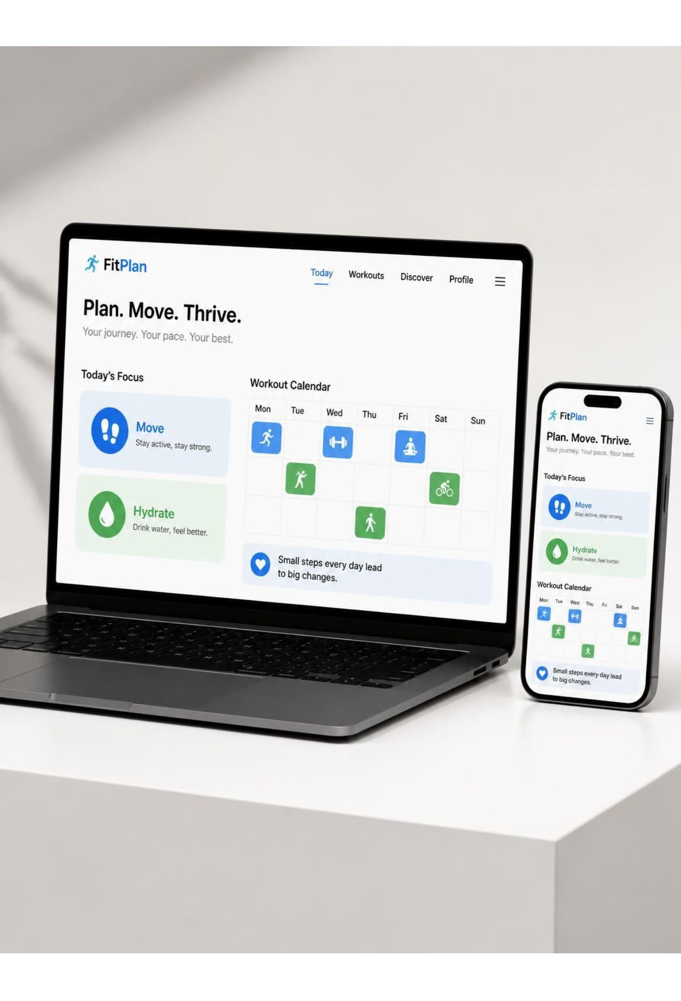




One dashboard for tracking and planning
Track daily
Plan ahead
Centralized steps, workout duration, calories burned, and water intake.
Personalized daily and weekly workout plans.
See progress
Keep it simple
Progress charts and goal completion indicators.
A user-friendly interface for everyday use.

Slide 4

From daily input to
progress review
Log the activity. Make the next workout easier to plan.
01
02
03
04
05
User Input
Activity Tracking
Data Processing
Dashboard Visualization
Progress Monitoring
Enter daily activity details.
Record fitness information.
Calculate totals and progress.
Show daily and weekly performance.
Review progress and plan workouts.
Notes:
Follow the flow left to right: User Input → Activity Tracking → Data Processing → Dashboard Visualization → Progress Monitoring.

Slide 5
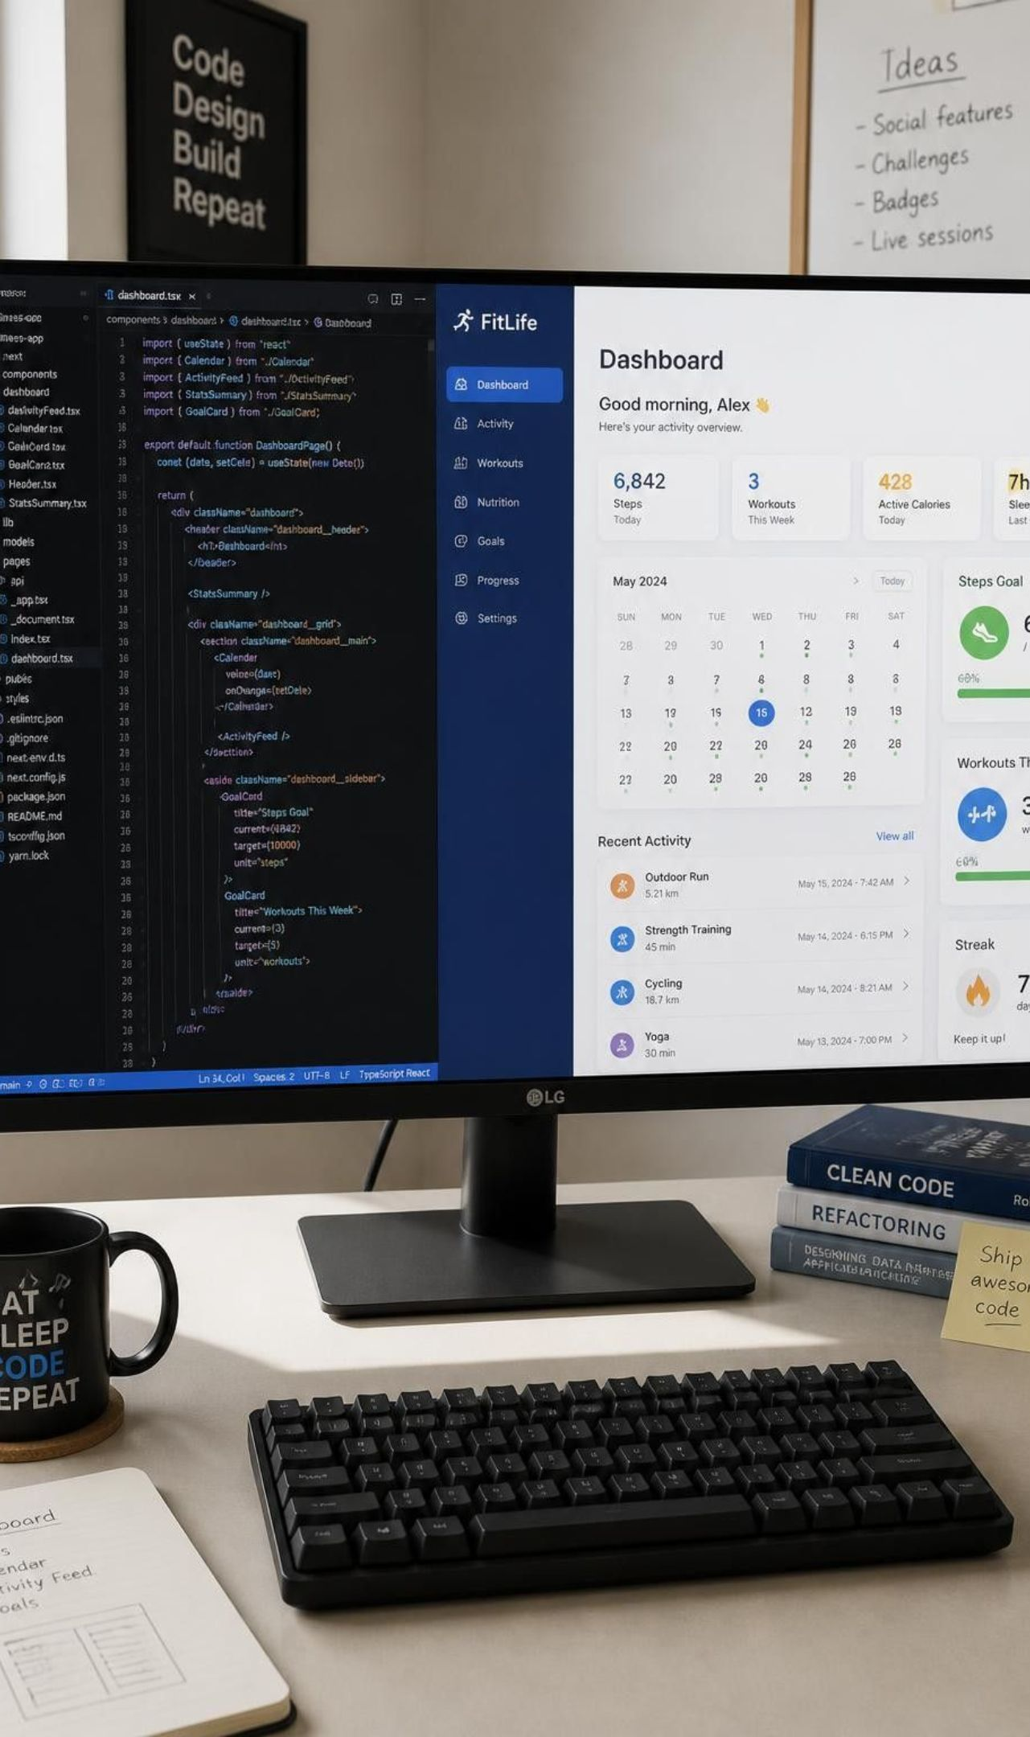
A simple, flexible web stack
Frontend + charts
HTML, CSS, JavaScript; optional React. Chart.js for visualization.
Backend
Node.js and Express.
Database
MongoDB or MySQL.
Algorithms
Daily activity totals, goal completion percentage, and weekly progress comparison.
Stack can be adjusted to the project implementation.

Slide 6
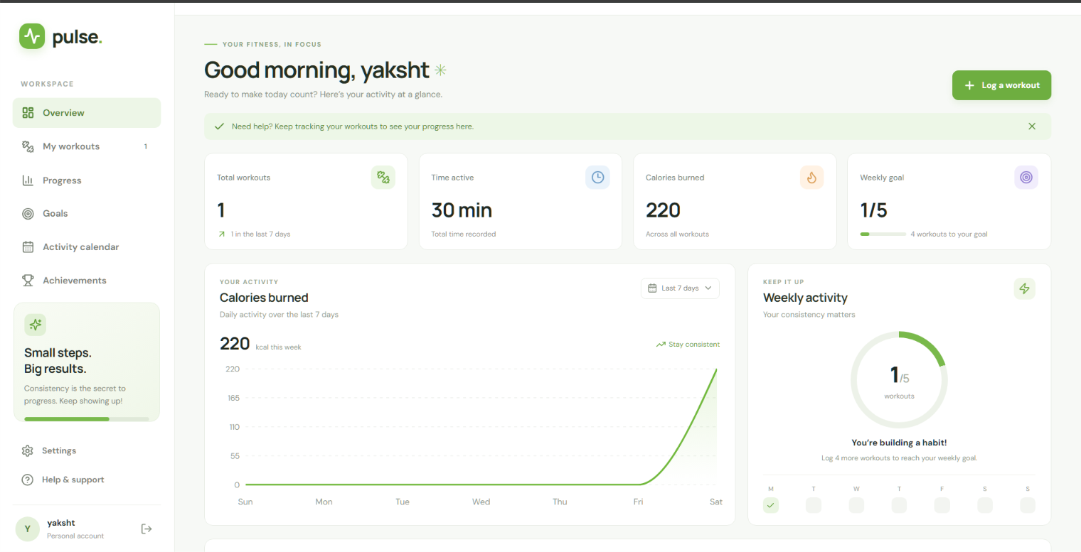
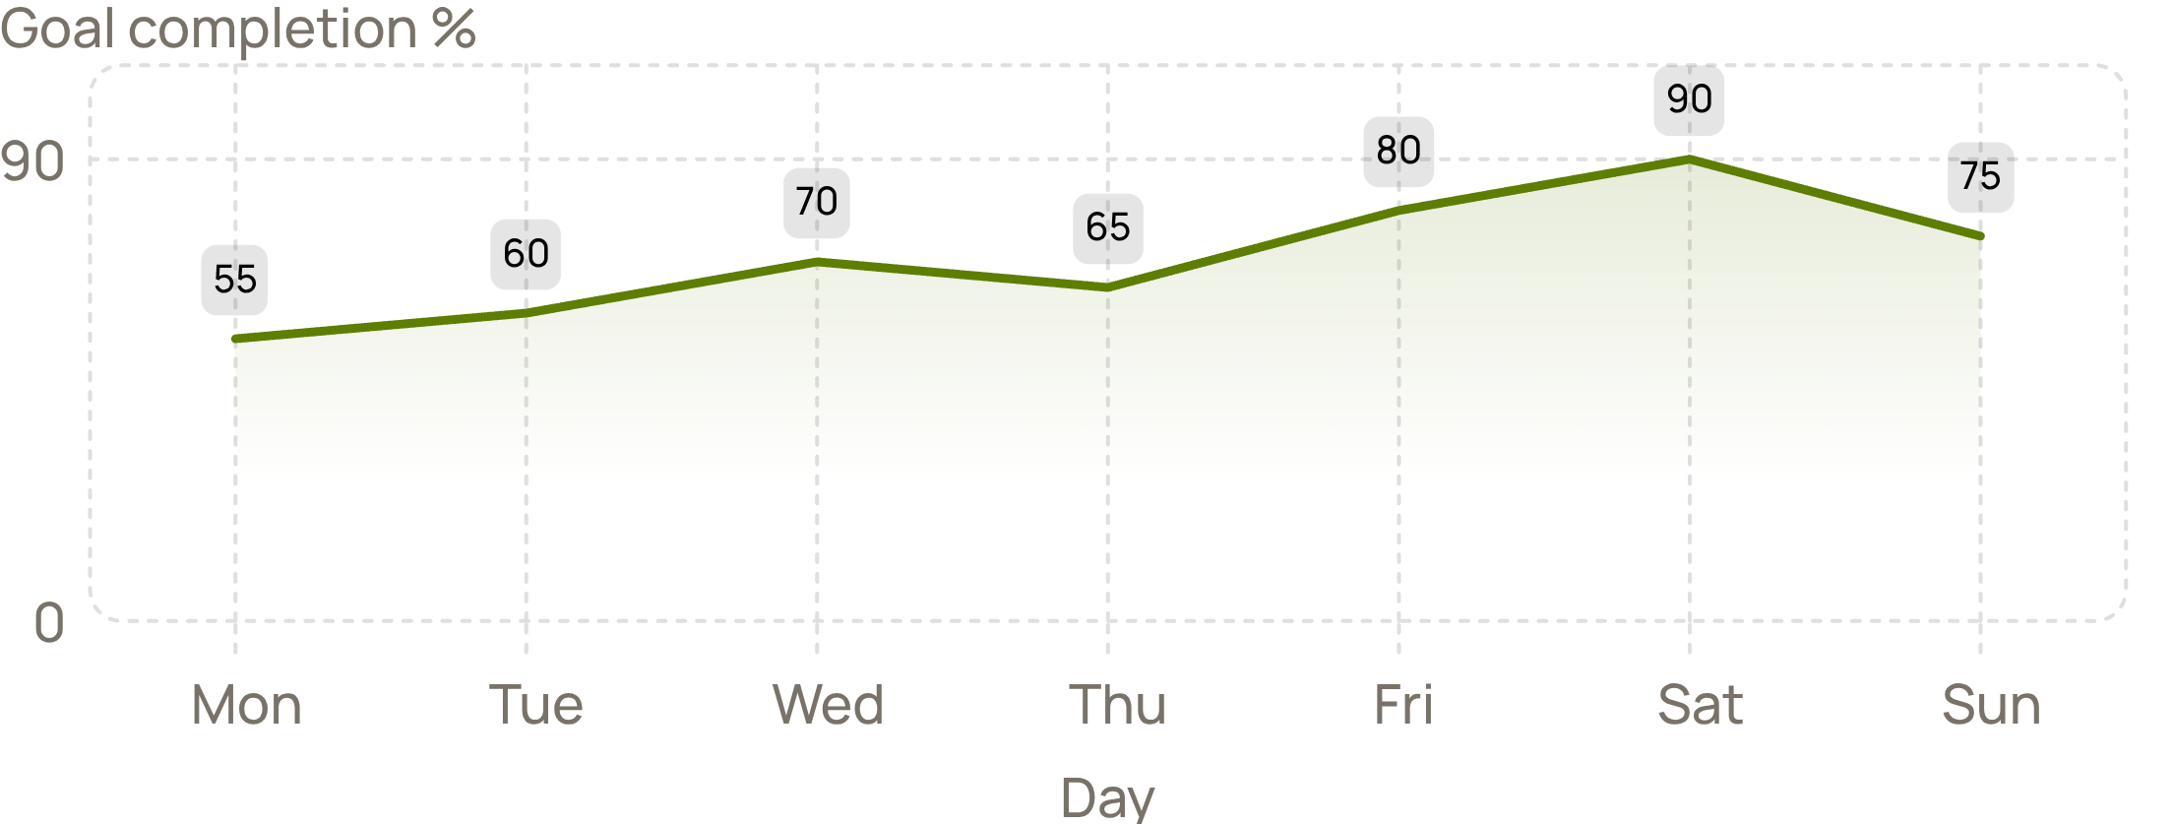
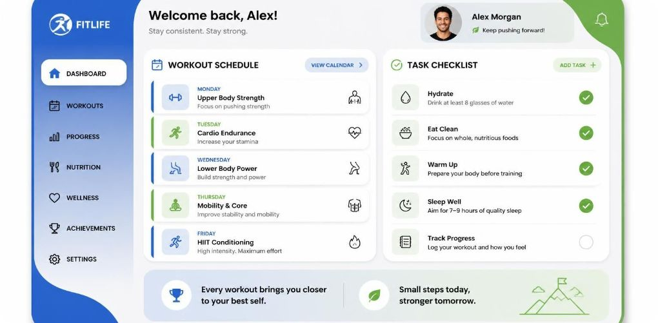
Demo: a sample day, and the impact
7,500
30 min
6 glasses
75%
Daily steps
Workout duration
Water intake
Daily goal completed
Weekly progress chart, workout schedule, task checklist.
Weekly fitness progress (sample). Sample values, not real user data.
Designed for consistent habits, clearer progress, organized schedules, and better daily awareness.
Notes:
The demo uses illustrative values, not real user data. Weekly completion rises overall from Monday to Sunday, with variation during the week. These values demonstrate the interface, not measured health outcomes.

Slide 7

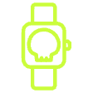
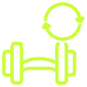


Where we go next
Connect devices
Personalize workouts
Smartwatch and fitness band integration. Automatic activity tracking.
Personalized workout recommendations. AI-powered activity insights.
Keep plans visible
Go mobile
Reminders and notifications.
Mobile app support.
Plan Your Fitness. Track Your Progress. Achieve Your Goals.
Notes:
These are future capabilities rather than claims about the current implementation. Close with the project's promise: Plan Your Fitness. Track Your Progress. Achieve Your Goals.

Slide 8
